Slide 1
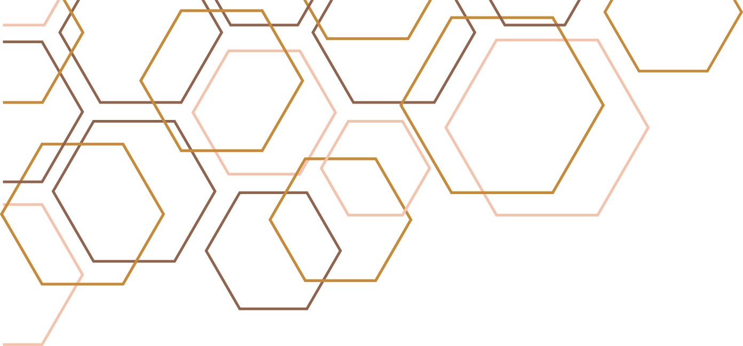

CircuitGuard
PCB DEFECT DETECTION AND CLASSIFICATION APPLICATION
BY AKASH PATEL

Slide 2
Problem Statement
Problem:
Manual PCB inspection is slow and error-prone
Need for automated defect detection & classification
Objective: Build a system to detect, classify, and visualize PCB defects efficiently

Slide 3
Project Objectives
Detect & localize defects using image comparison
Classify defects into categories using CNN (EfficientNet-B4)
Build web-based frontend for image upload & visualization
Export annotated outputs and logs for analysis

Slide 4
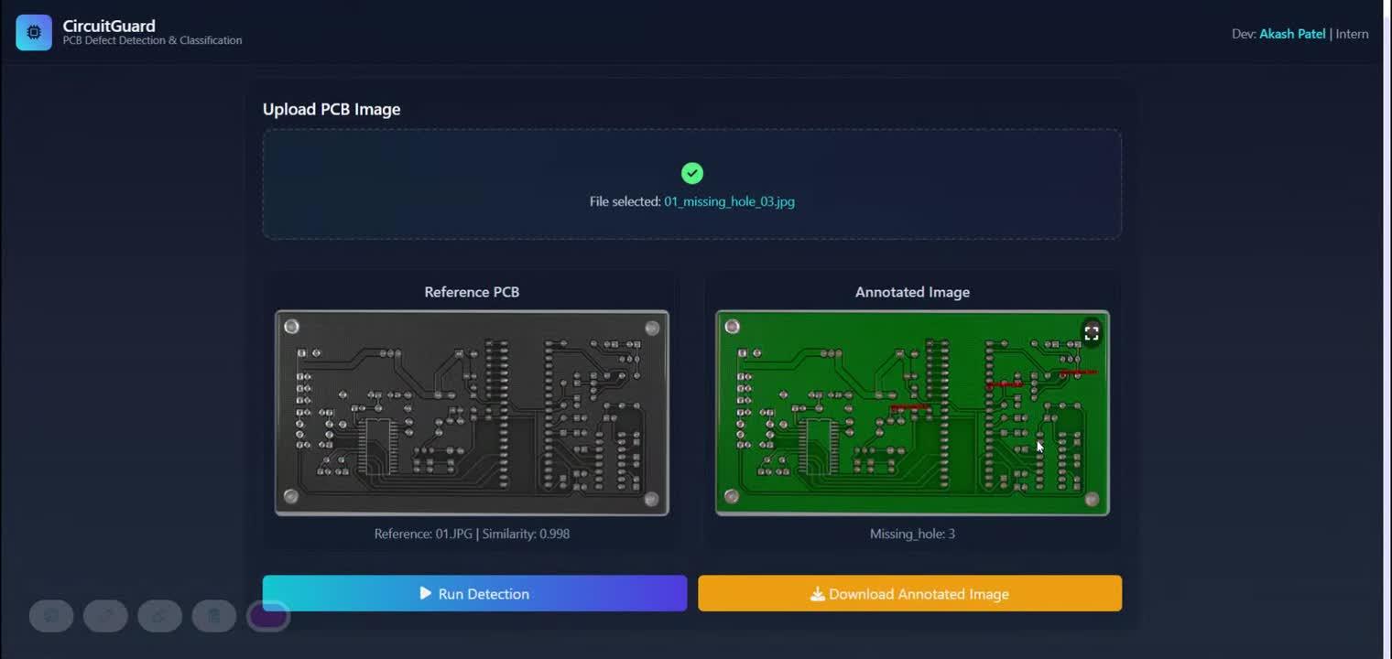
Demo Video

Slide 5
Methodology
Image Preprocessing & Subtraction – Noise reduction, alignment, difference map
Contour Detection & ROI Extraction – Highlight defect areas
CNN Classification (EfficientNet) – Train & classify defect types
Frontend & Backend Integration – Upload images, get annotated outputs

Slide 6
Image Preprocessing
Dataset: DeepPCB (Template + Test images)
Tasks: Image alignment, subtraction, thresholding
Output: Highlighted defect maps ready for training

Slide 7
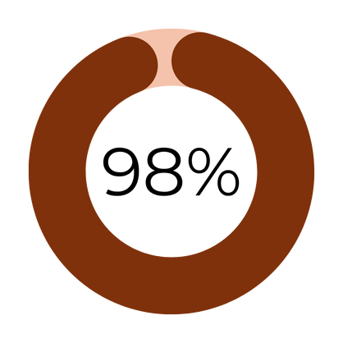
Model Training & Evaluation
Training:
Model: EfficientNet-B4 (PyTorch)
Early stopping at epoch 9
Final Accuracy: Train 99.16%, Val 98.69%
Classification Report:
Test Accuracy: 98%
High precision & recall across all defect classes

Slide 8
Frontend & Backend
Integration
Frontend: HTML/CSS – Upload & display results
Backend: Modular inference pipeline with EfficientNet and Flask server
Features: Real-time display, bounding boxes, labels, download annotated imag

Slide 9
System Performance Overview
Milestone | Matrix | Target
M1 | Mask quality & bbox accuracy | xDetect all defects
M2 | Accuracy & confusion matrix | 98%
M3 | UI upload-to-output time | 1.3 per image

Slide 10
Future Improvements
1. Real-time PCB Scanning – Integrate camera-based live inspection for faster defect detection.
2. Mobile Application Support – Enable defect detection on mobile devices for on-the-go use.
3. Advanced Defect Classification – Add more defect categories or use multi-label classification.
4. Pipeline Optimization – Reduce inference time, improve preprocessing and model speed.

Slide 11
Thank you

